Slide 1
(Almost) Zero-Shot Cross-lingual Spoken Language Understanding
Shyam Upadhyay (University of Pennsylvania)
Manaal Faruqui (Google Research)
Gokhan Tür (Google Research)
Dilek Hakkani-Tür (Google Research)
Larry Heck (Samsung Research)

Slide 2
Motivation
Spoken language understanding (SLU) is a key component of goal-oriented dialogue systems.
Labeled data for training a SLU model hard to come by in most languages, creating a language-dependent barrier.
Can we develop a SLU model for a new language with little supervision in that language and achieve reasonable performance?

Slide 3
Cross-lingual SLU
Utt:
find a one way flight from boston to atlanta on wednesday
Slots:
B-RT I-RT
B-FC
B-TC
O O B-RT I-RT O O B-FC O B-TC O B-DDN
B-DDN
Intent:
Flight
Utt:
बुधवार को बोसटन से अटलांटा तक जाने वाली एकतरफ़ा उड़ाने खोजें
Slots:
B-DDN O B-FC O B-TC O O O B-RT O O
Intent:
Flight
B, I, O – Begin, Inside, Outside
RT – Round Trip
FC, TC – From City, To City
DDN – Depart Day Name

Slide 4
Previous Approaches for Cross-lingual SLU
Train on Target (Garcia et al. SLT 2012)
Test on Source (He et al. ICASSP 2013)
Adaptive Test on Source (He et al. ICASSP 2013)
MT
Hindi
SLU Model
SLU Predictions
English Train
Hindi Train
?
Hindi Test
?
MT
English
SLU Model
SLU Predictions
?
Hindi Test
English Test
  Drawbacks
All approaches use a MT model.
No parameter sharing across languages.

Slide 5
Overview of Our Approach
English Test
?
English Train
Joint Training
Bilingual SLU Model
SLU Predictions
Hindi Train (Small)
?
Hindi Test
    Advantages
Avoids using a MT model in the pipeline.
Can operate on multiple languages simultaneously.
Joint training allows parameter sharing across languages.
How to enable joint training?

Slide 6
Cross-lingual Embeddings = Continuous Approx. of Translation Dictionaries
Klementiev et al. (COLING 2012)
Faruqui and Dyer (EACL 2014)
Sogaard et al. (ACL 2015)
Upadhyay et al. (ACL 2016)
and many others …
Vectors in English
English | Hindi
wednesday | बुधवार
law | कानून
cost | क़ीमत
country | ??
?? | अमन
?? | बाजार
law
कानून
बुधवार
wednesday
market
country
बाजार
देश
Vectors in Hindi
क़ीमत
cost
peace
अमन

Slide 7
Neural SLU (Naïve Model)
LSTM Cell
Softmax Op
Mesnil et al. (TASLP 2015)
Hakkani-Tur et al. (Interspeech 2016)
Liu and Lane (Interspeech 2016)
and many others …
: Flight
: B-FC O B-TC O O
बोसटन से कोलंबस तक उड़ाने

Slide 8
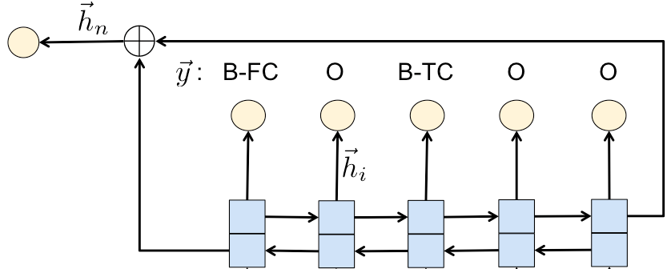
Zero-Shot SLU with Cross-lingual Embeddings
SLU Predictions
Trained Naïve Model
Pre-trained English vectors
Pre-trained Hindi vectors
Hindi Test Data
English Train Data
?

Slide 9
Bilingual Model
: Flight
: B-FC O B-TC O O
: B-FC O B-TC B-RT I-RT
language
indicator
milwaukee to denver one way
बोसटन से कोलंबस तक उड़ाने

Slide 10
Evaluation Setup
Target Languages: Hindi and Turkish.
Test utterances and 600 train utterances from English ATIS were translated by native speakers.
Bilingual Mechanical Turk annotators were asked to mark the slot values in the translations.
find a one way flight from boston to atlanta on wednesday
बुधवार को बोसटन से अटलांटा तक जाने वाली एकतरफ़ा उड़ाने खोजें
बुधवार को बोसटन से अटलांटा तक जाने वाली एकतरफ़ा उड़ाने खोजें
B-DDN O B-FC O B-TC O O O B-RT O O

Slide 11
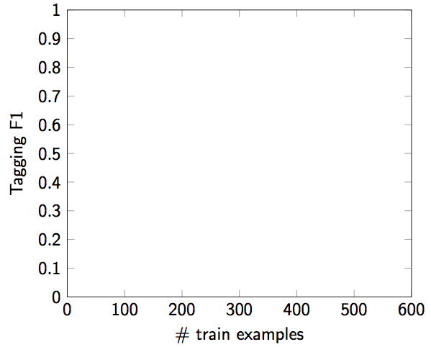
Slot Filling Results

Slide 12
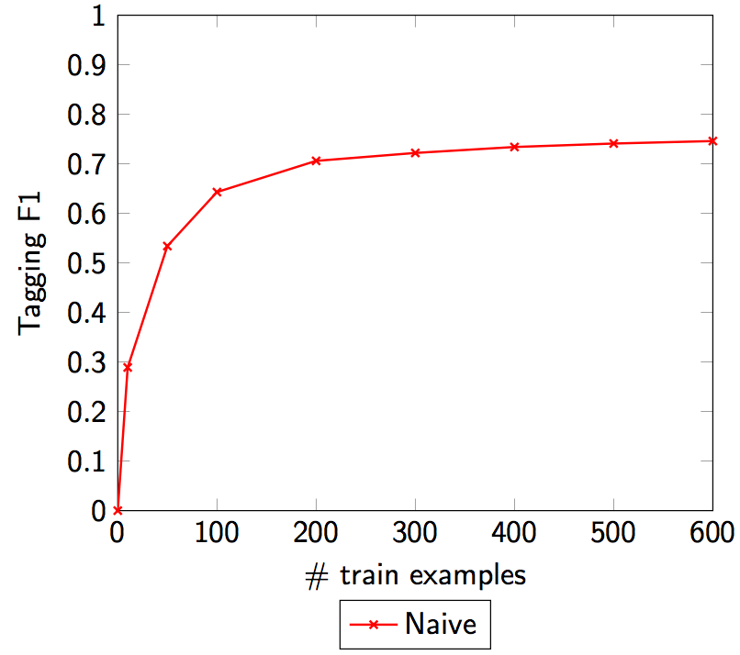
Slot Filling Results (Hindi)

Slide 13
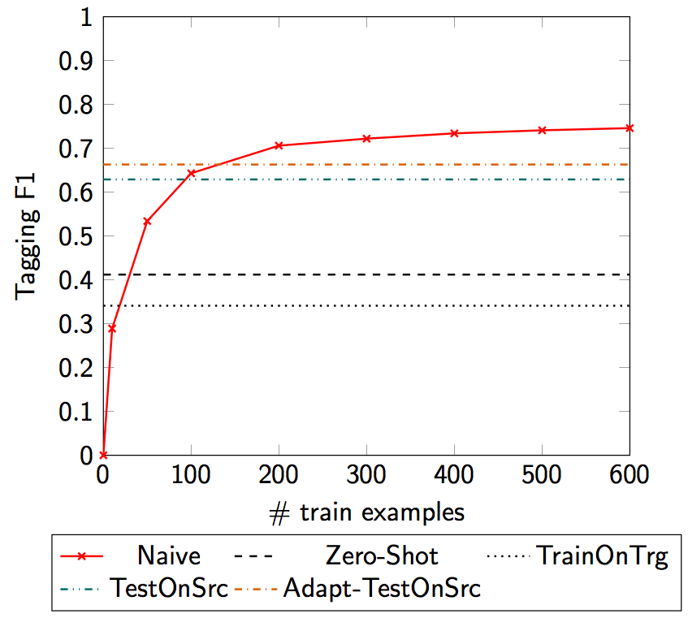
Slot Filling Results (Hindi)

Slide 14
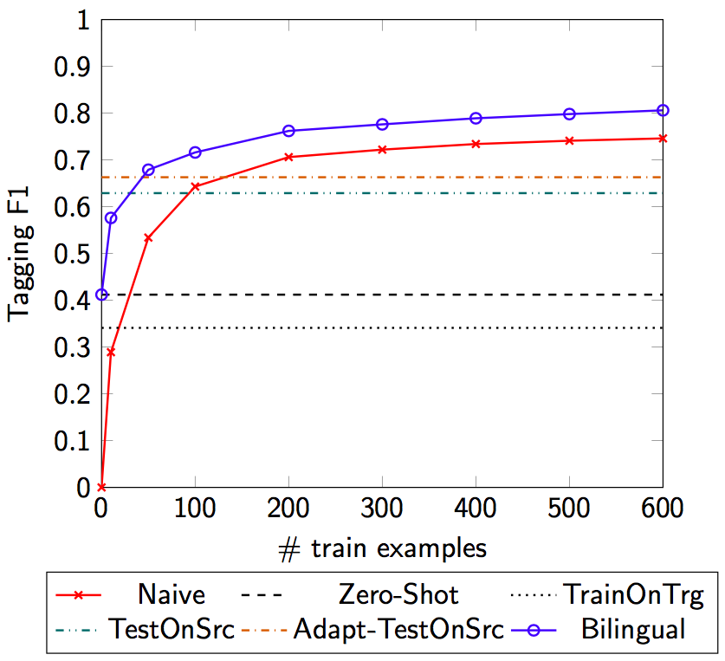
Slot Filling Results (Hindi)

Slide 15
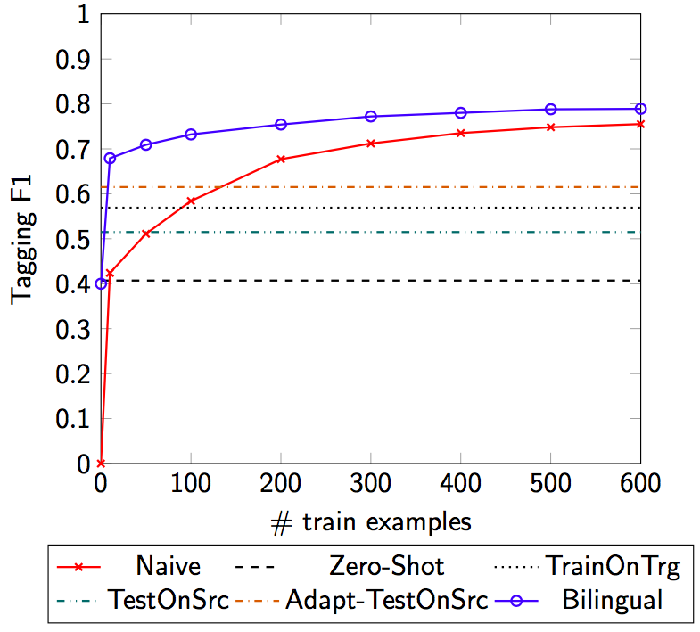
Slot Filling Results (Turkish)

Slide 16
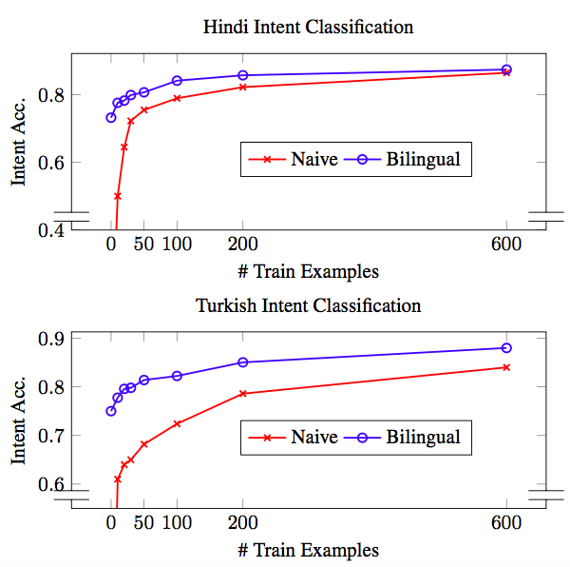
Intent Classification Results

Slide 17
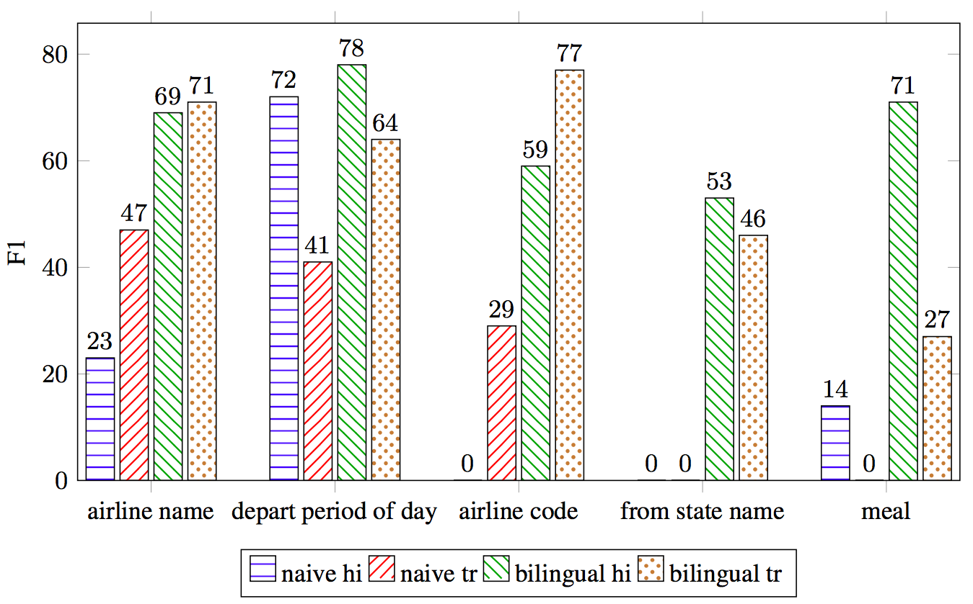
Per Slot Analysis
Per Slot F1 with only 100 training examples in the target language
Bilingual training helps in learning patterns indicative of rare slot types with much less data.

Slide 18
Key Take-Aways
“A little supervision in the target language goes a long way”
  Both naïve and bilingual model better than zero-shot, train on target and test on source approaches with ~100 examples.
Joint training reduces the supervision required to reach a certain performance.
  3x reduction in # examples compared to the naïve model.
Rare slot types benefit more from joint training than frequent slot types.

Slide 19
What’s Next?
More Parameter Sharing across Languages
  Character level modeling (languages with same script)
  Fully multi-lingual extension of our bi-lingual approach.
Multi-lingual SLU models for code-switching.
  Hindi + English, Spanish + English, French + Tamil …
Joint modeling with multiple domains (airlines, hotel booking etc.) across multiple languages …

Slide 20
Thanks!
Evaluation data for Hindi and Turkish will be available through LDC. Instructions to obtain the data can be found here
  github.com/google-research-datasets/dialogue/tree/master/multilingual-atis
Questions?

